Slide 1
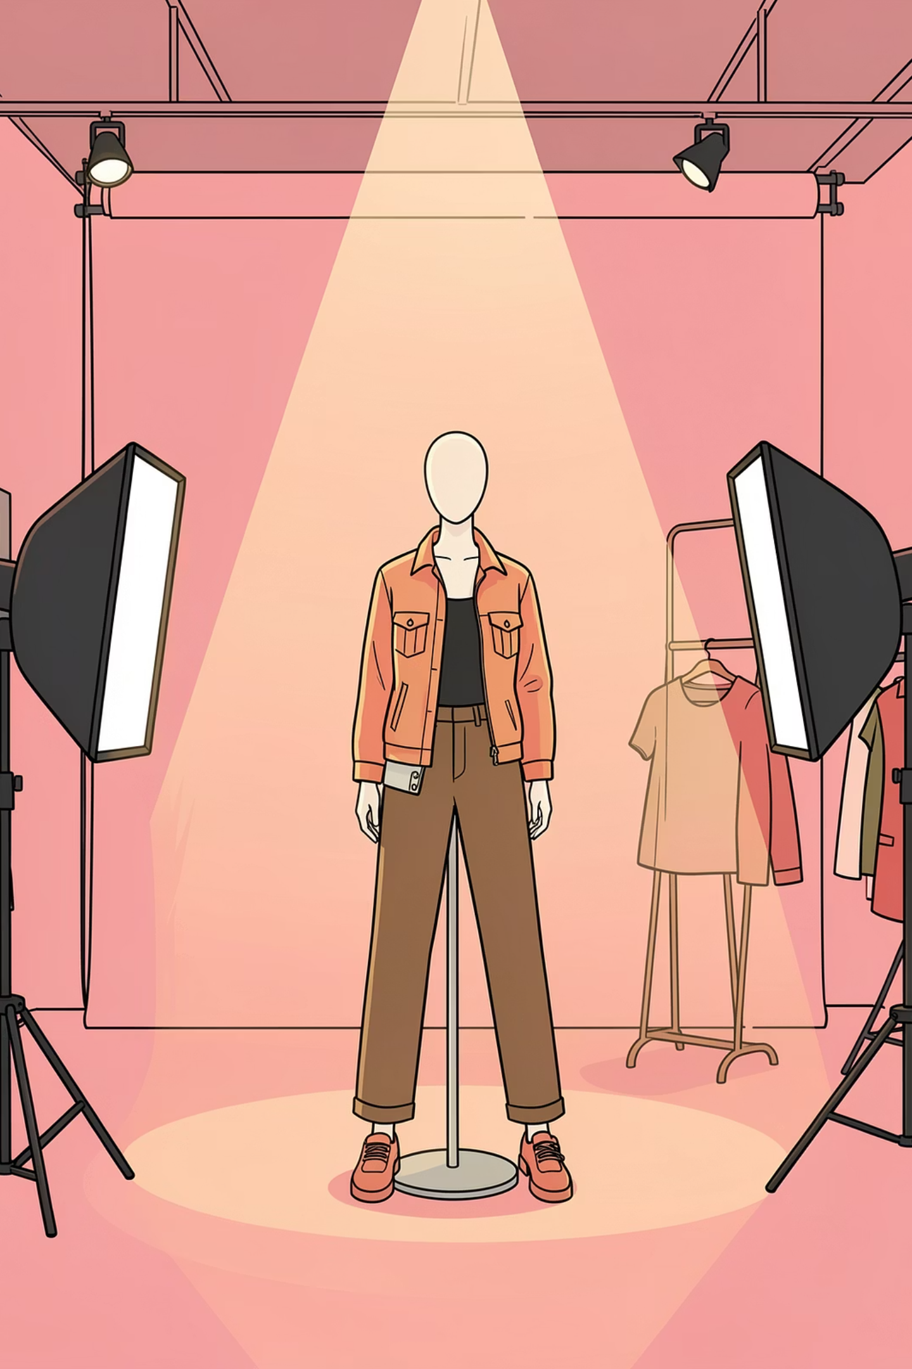
Fashion Visualization Studio
Precision garment rendering for designers, photographers, and production teams

Slide 2
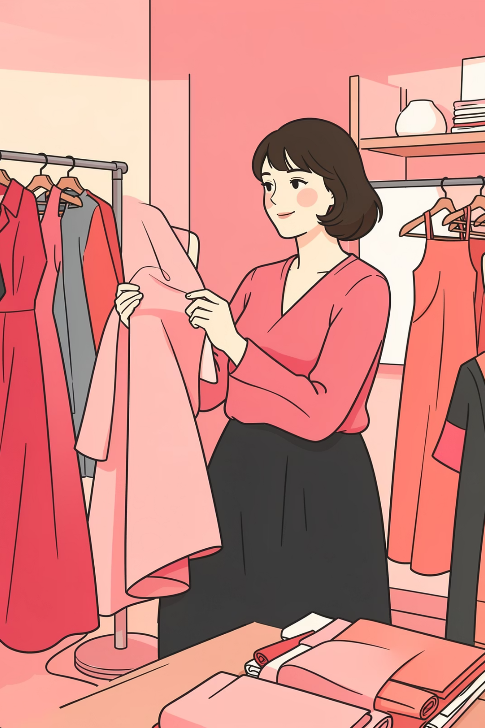
Transform Concepts into Reality
From Sketch to Sample
E-Commerce Ready
Visualize designs before production, reducing sampling costs and accelerating time to market
Studio-quality imagery for online catalogs, campaigns, and client presentations

Slide 3




Four-Step Process
Input Selection
Size Mapping
Choose fabric, color, pattern, and garment type
Select size to determine fit profile
Reference Setup
Render Output
Upload photo or use neutral mannequin
Receive high-resolution, studio-quality image

Slide 4
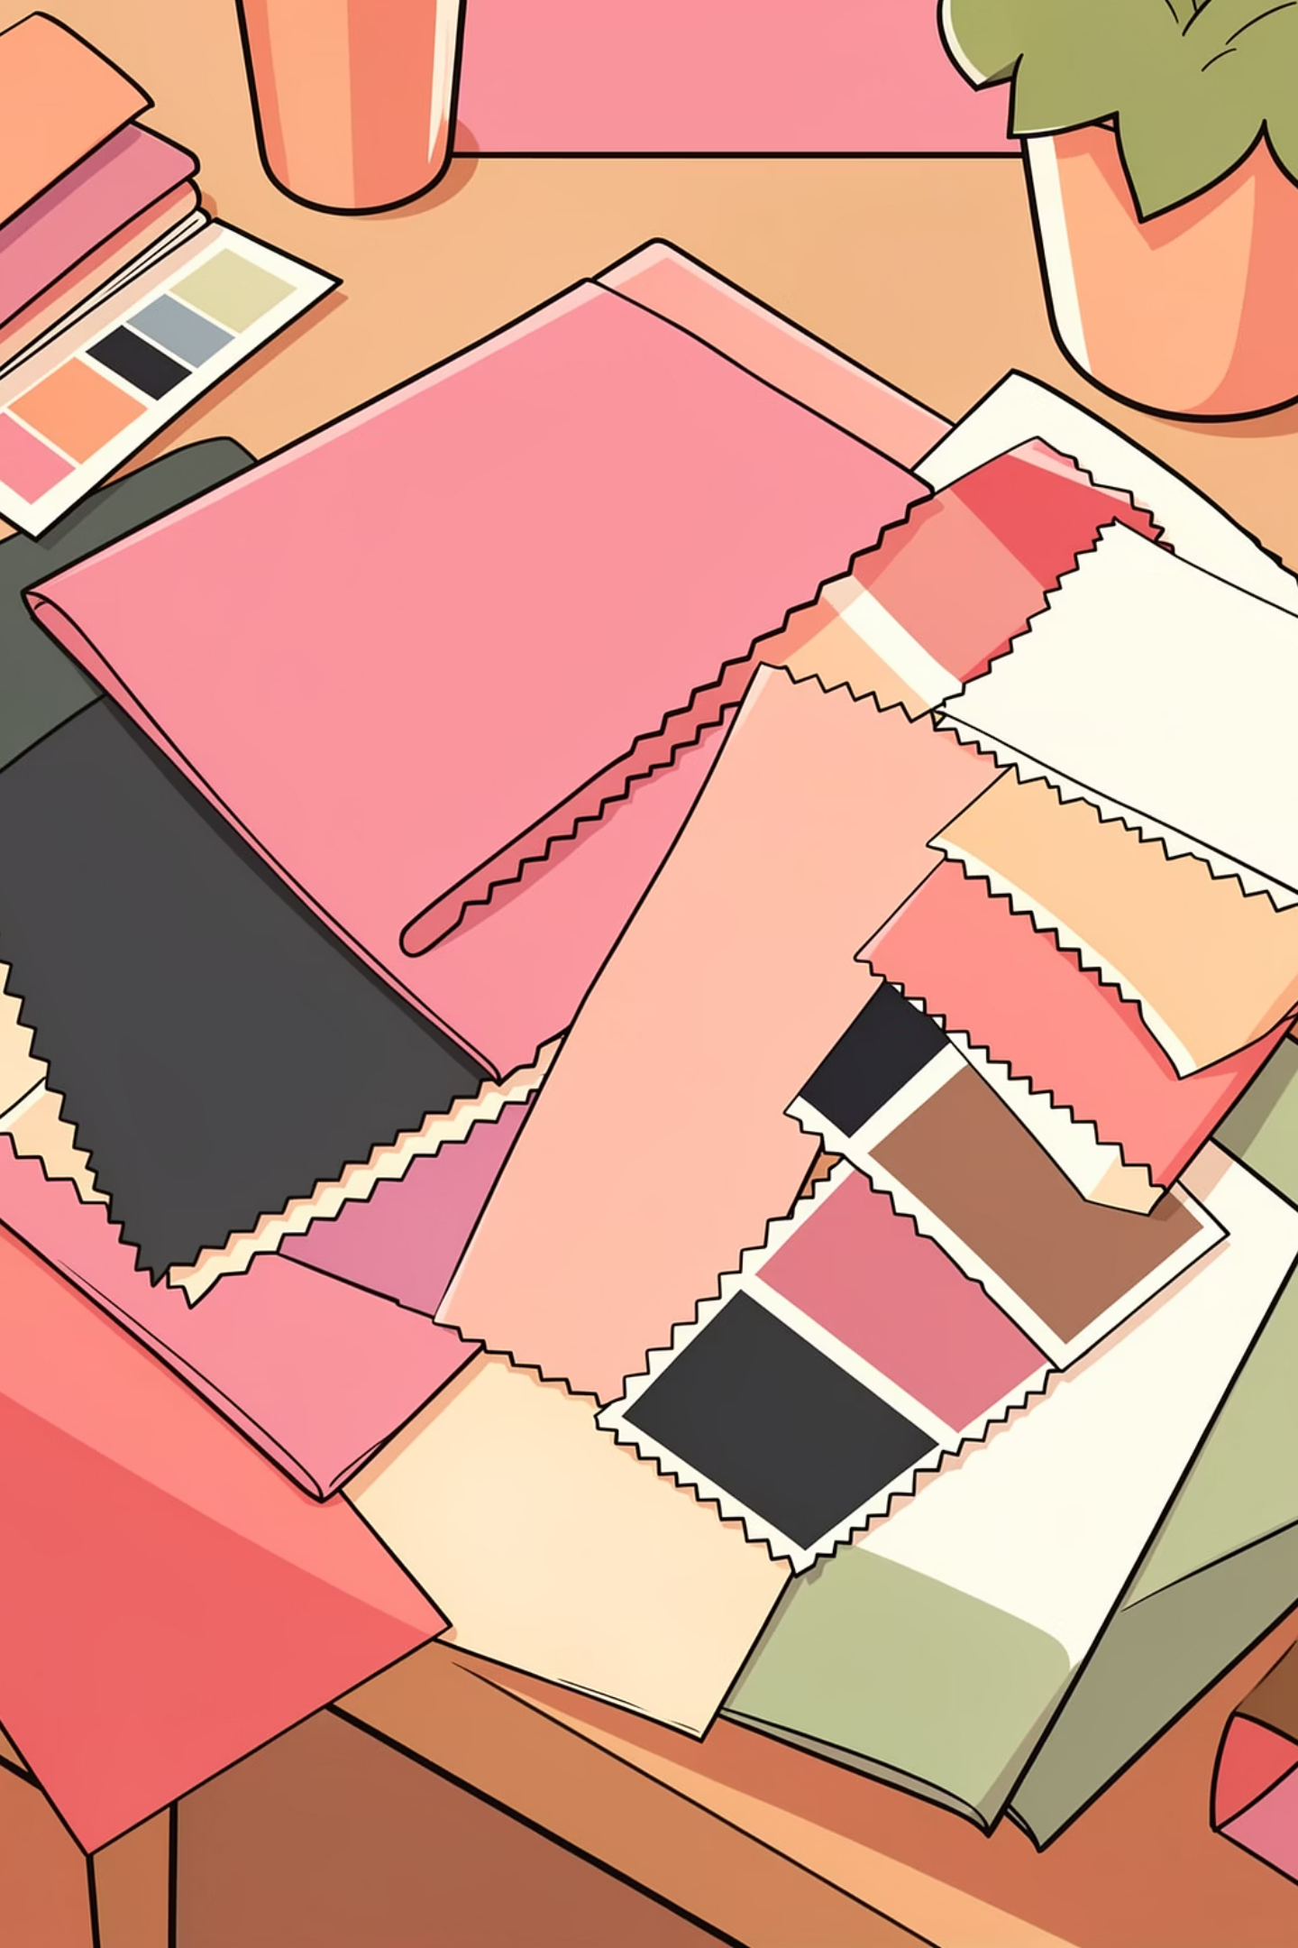

Material & Color System
Fabric Types
Color Matching
Cotton, silk, denim, knit, velvet, and specialty textiles
Pantone-equivalent accuracy with natural dye variations
Pattern Integration
Seamlessly apply uploaded designs as garment textures

Slide 5
Size-to-Fit Translation
1
2
Small
Medium
Slim, body-conscious silhouette with minimal ease
Standard fit with comfortable wearing ease
3
4
Large
Extra Large
Relaxed cut with generous proportions
Oversized, loose-fitting contemporary styling

Slide 6
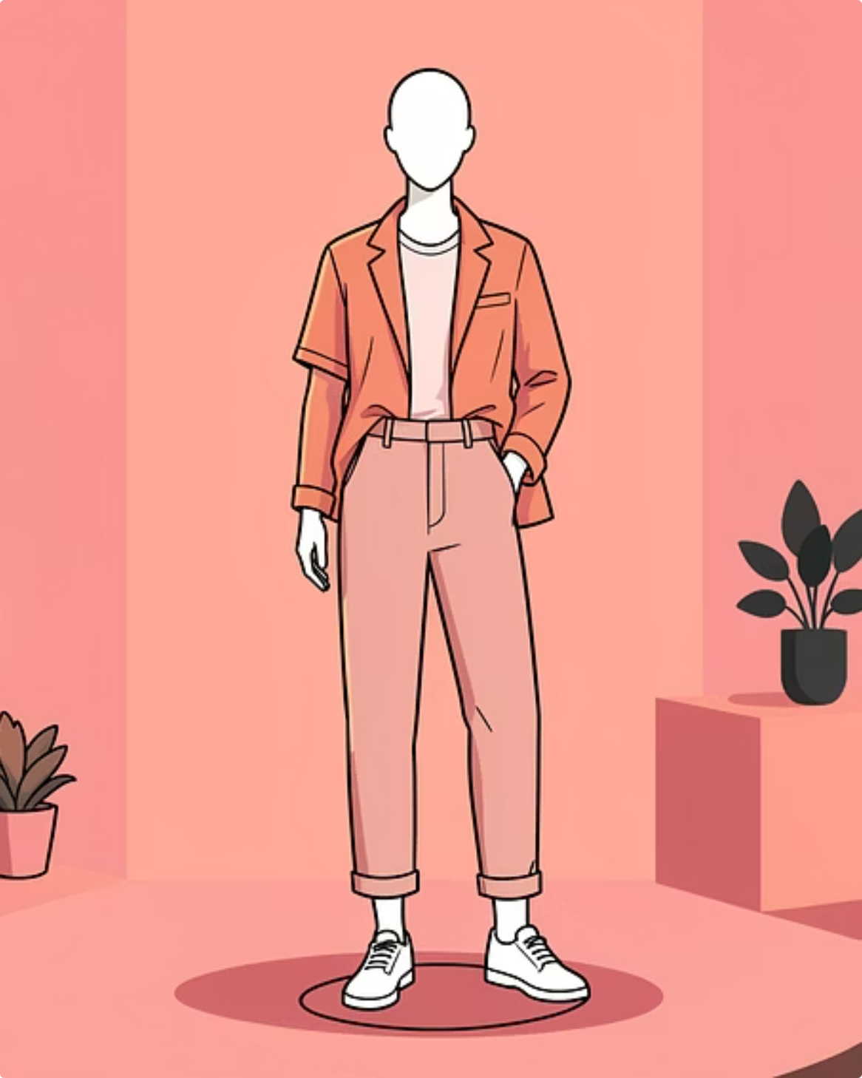
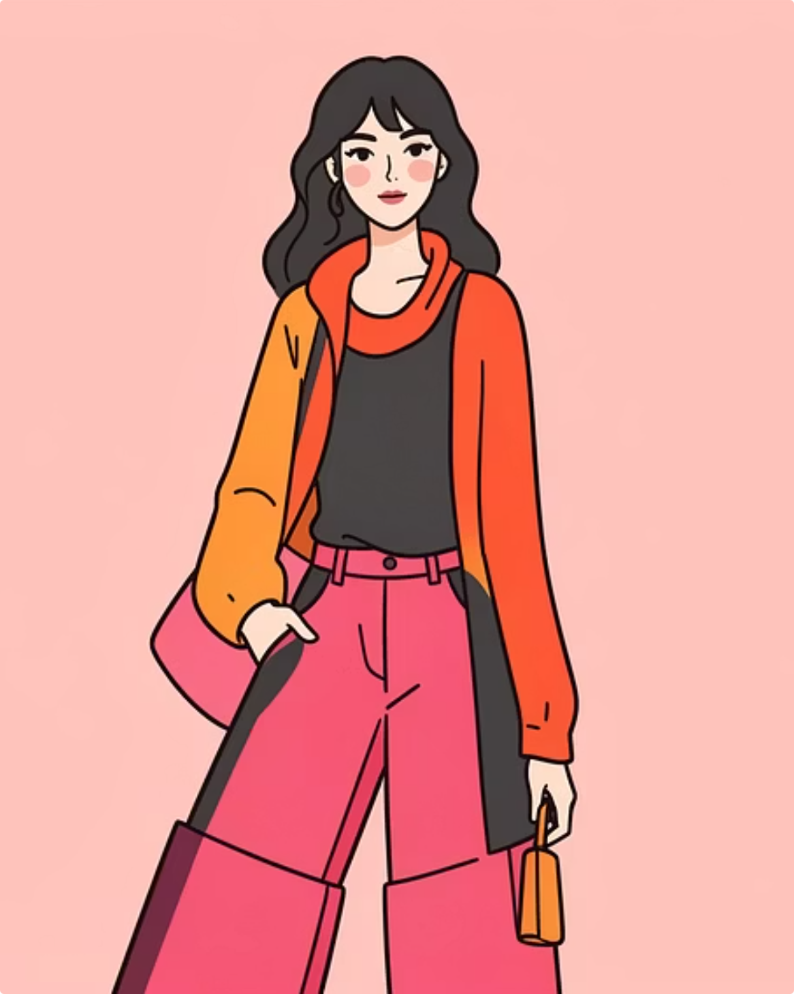
Reference Options
Neutral Mannequin
Human Photo
Standard presentation with correct proportions and pose
Apply garment to uploaded image, preserving face and body details

Slide 7
Visual Excellence Standards
Studio Photography
Fabric Realism
Professional lighting with soft shadows and even exposure
Natural drape, folds, texture, and weight simulation
Precision Fit
Clean Output
Correct proportions, symmetry, and garment engineering
Neutral background, sharp focus, no artifacts or distortion

Slide 8
Design Guidelines
01
02
Natural Fabric Behavior
Seamless Pattern Application
Weight, drape, and texture must reflect real textile properties
Uploaded designs wrap smoothly without stretching or distortion
03
04
Accurate Fit Mapping
Body Preservation
Size selections produce appropriate ease and silhouette
Face, hands, and posture remain unaltered when using human photos

Slide 9
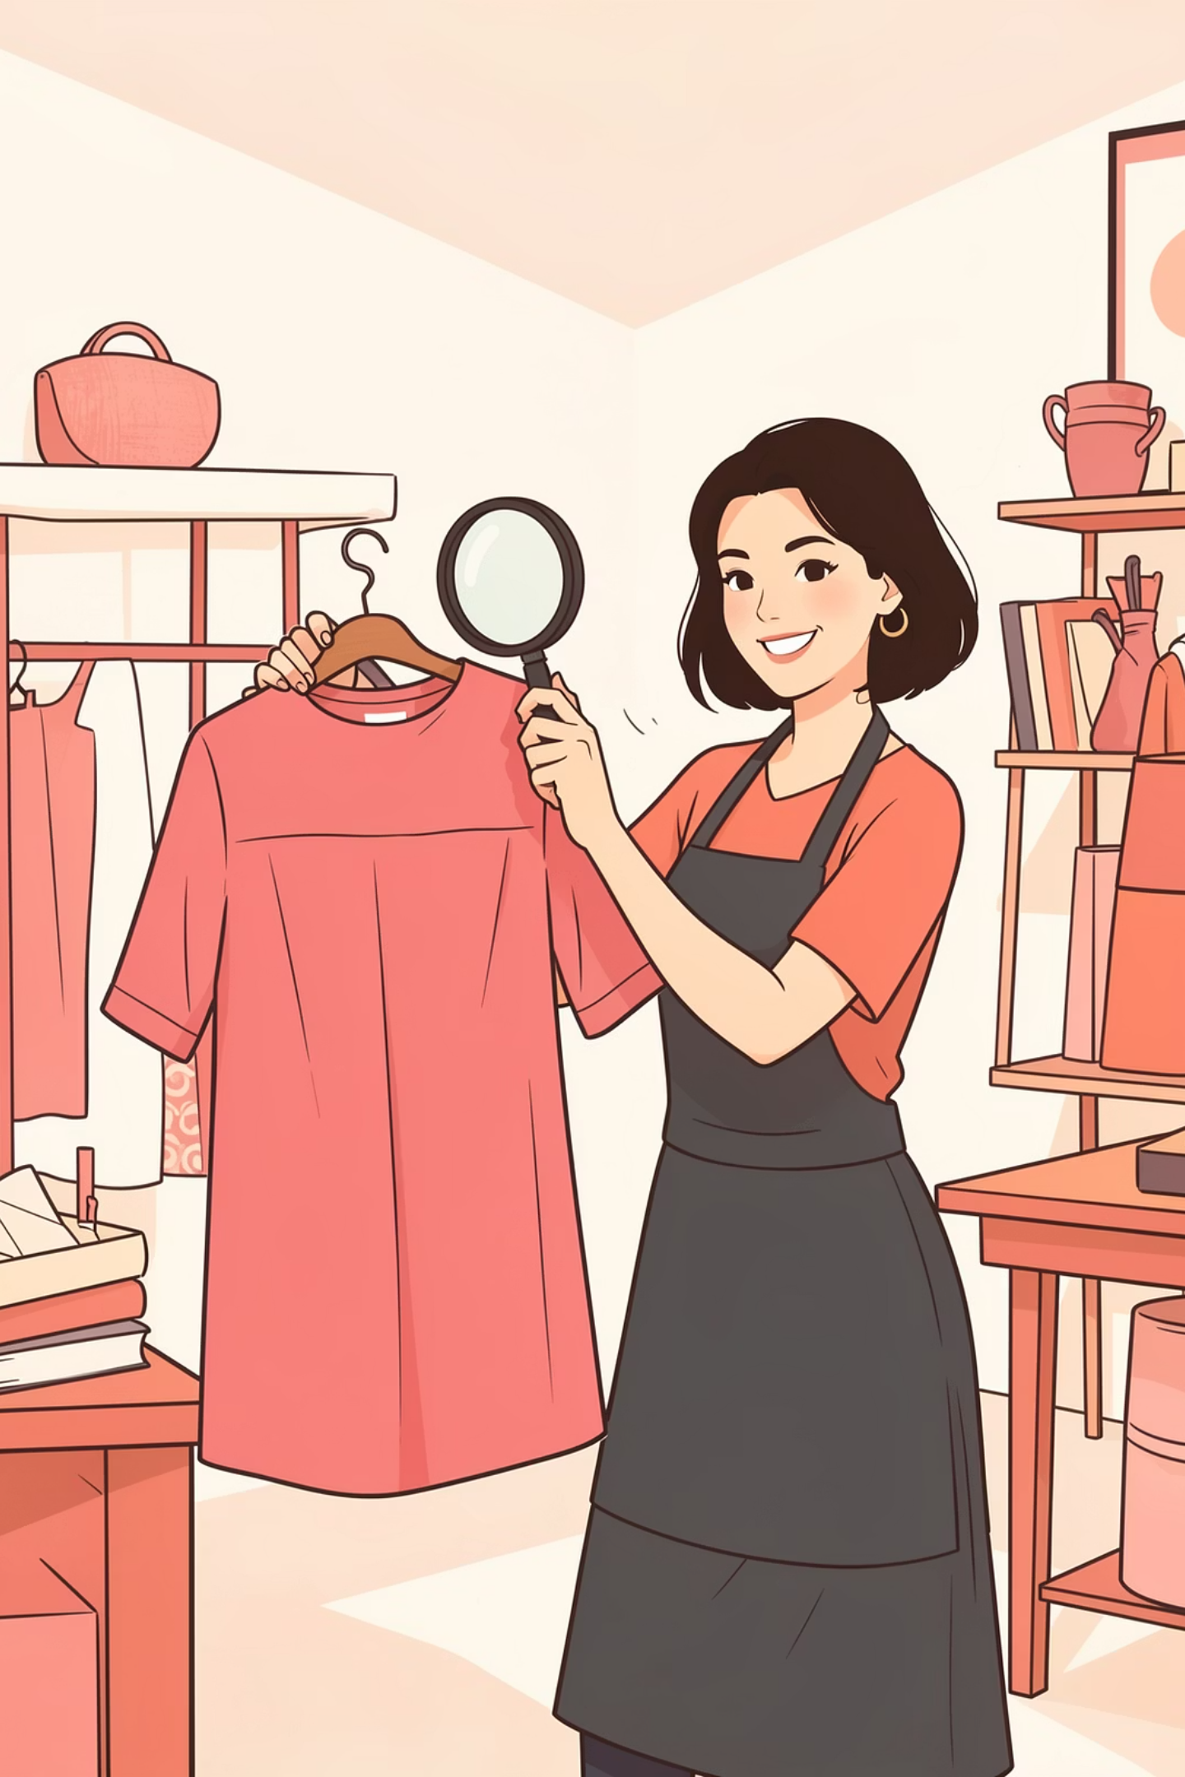
Quality Assurance
No Distortion
No Exaggeration
Body proportions, face, and hands maintain natural anatomy
Realistic styling without impossible poses or fabric behavior
No Clutter
Clean background with no unwanted artifacts or distractions

Slide 10
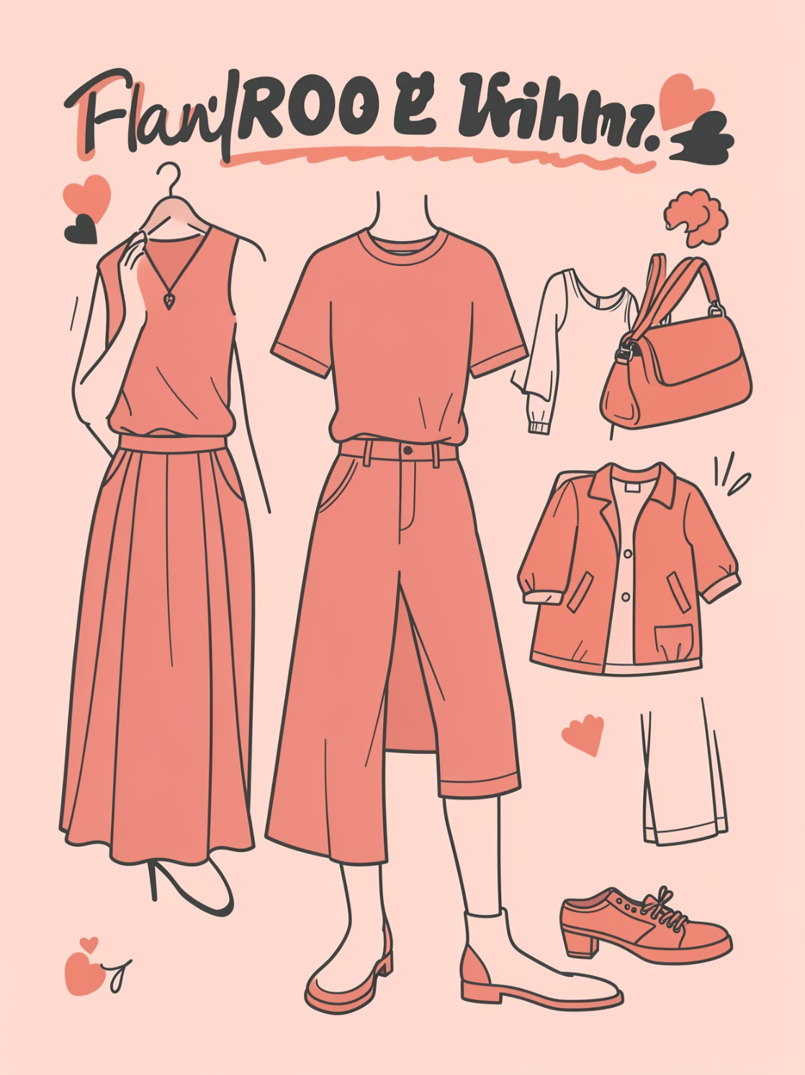
Ready for Production
High-Resolution Output
Studio-quality images optimized for e-commerce, catalogs, and presentations
Fast Turnaround
From concept to visualization in hours, not weeks
Cost-Effective
Reduce sampling expenses while maintaining design integrity

